Slide 1
HASH DATA ANALYTICS INTERNSHIP
TITLE:
ATTRITION CONTROL
PROOF OF CONCEPT

Slide 2
NAME : ADEROJU
OMOBOLAJI
COUNTRY: NIGERIA
EMAIL :aderojuomobolaji@gmail.com
PROJECT TITLE : ATTRITION CONTROL

Slide 3
PROBLEM STATEMENT
Employee attrition must be decreased for a firm as it increases the high training cost and the crucial business time of an organisation.
The data is for company X which is trying to control attrition. There are two sets of data: “Existing employees” and “Employees who have left”. Following attributes are available for every employee:
Satisfaction Level
Last evaluation
Number of projects
Average monthly hours
Time spent at the company
Whether they have had a work accident
Whether they have had a promotion in the last 5 years
Departments (column sales)
Salary
Whether the employee has left

Slide 4
OBJECTIVES
What type of employee is leaving?
Determine which employees are prone to leave next.
SOLUTION METHODOLOGY
Merging up the two data set (Employees existing and Employees left) by adding an Attrition status to the dataset with values yes or no.
Converting string data types to numeric so the system would understand my dataset.
Built a model that will perfectly work to predict the attrition of employees for the company using DecisionTreeRegressor and Logical Regression
The dataset consist of 14999 rows of 11 columns

Slide 5
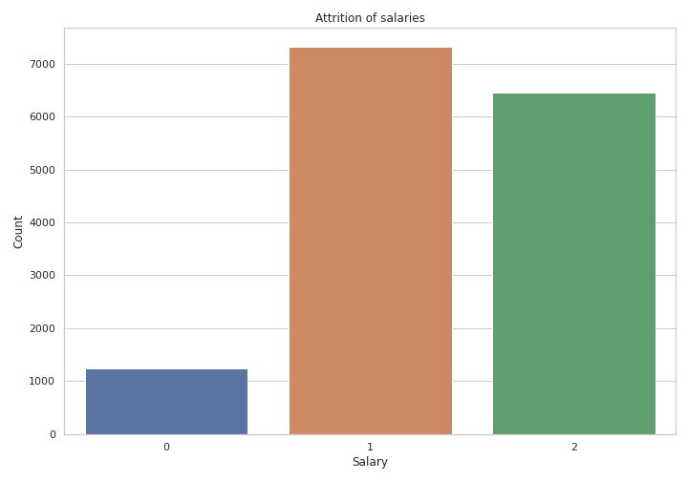
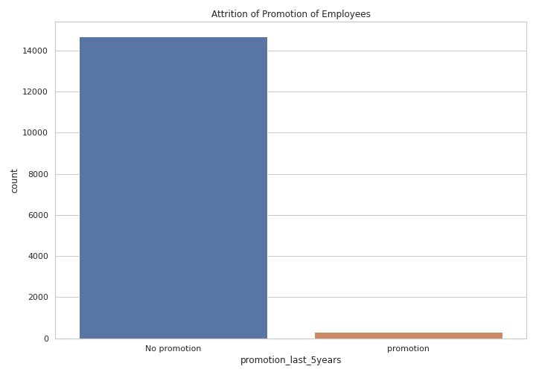
VISUALIZATION METHODOLOGY
ATTRITION BY SALARY
ATTRITION BY PROMOTION

Slide 6
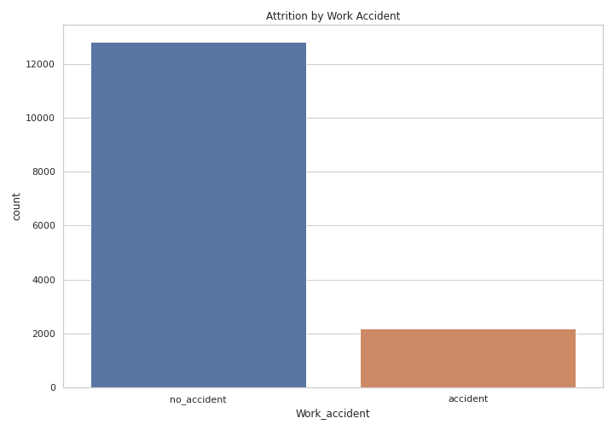
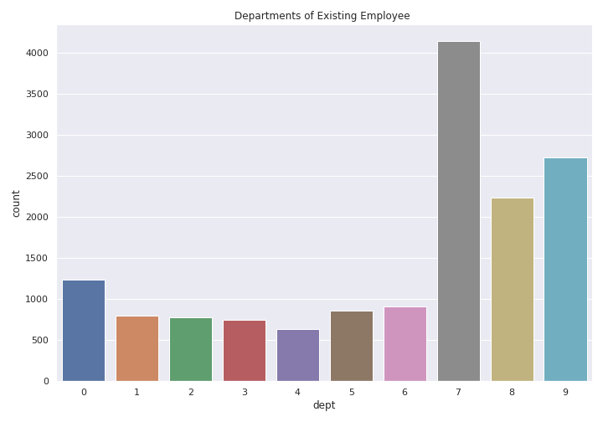
VISUALIZATION METHODOLOGY
ATTRITION BY WORK ACCIDENT
ATTRITION BY DEPARTMENT

Slide 7
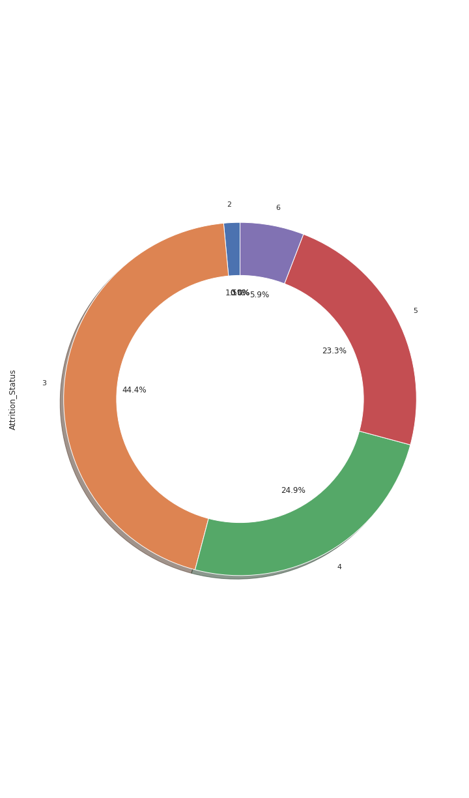
VISUALIZATION METHODOLOGY
ATTRITION BY TIME SPENT

Slide 8
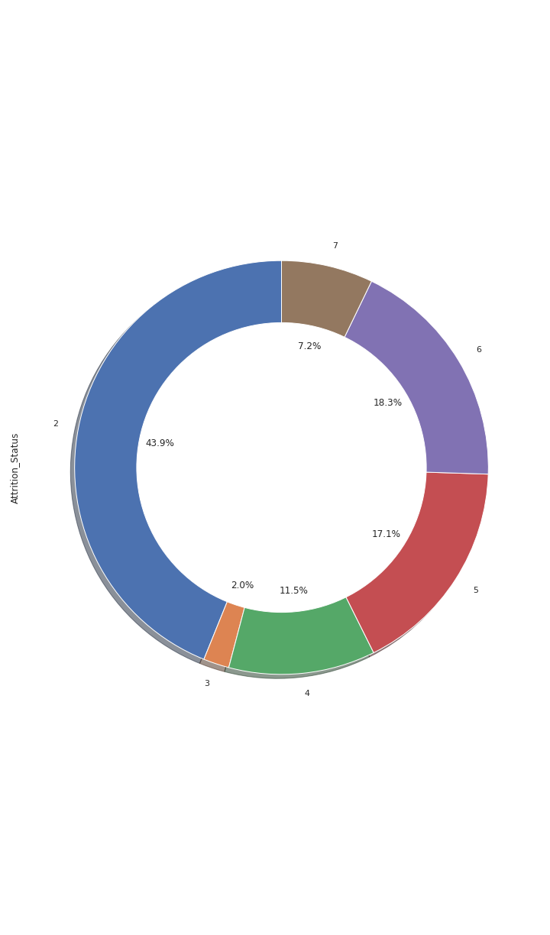
VISUALIZATION METHODOLOGY
ATTRITION BY NO OF PROJECT

Slide 9
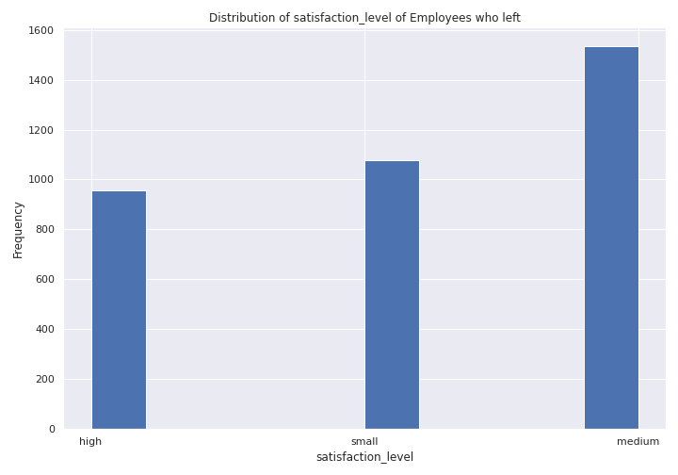
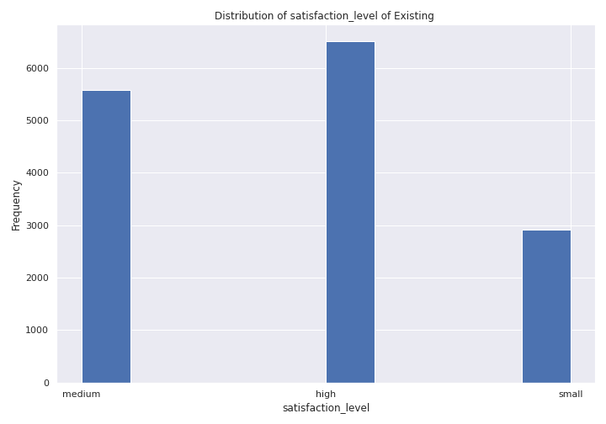
VISUALIZATION METHODOLOGY
ATTRITION BY SATISFACTION OF NON EXISTING WORKERS
ATTRITION BY SATISFACTION OF EXISTING WORKERS

Slide 10
VISUALIZATION OF
BUILDING THE MODEL AND PREDICTIONS
1. Using Scikit learn to import necessary libraries needed in structuring the data for the Model.
2. Splitting the train and test data by a ratio of 0.25. Then building the Decision Tree Model and Logical Regression Model.
3. Accuracy and Predictions. I got an average of 80% accuracy.

Slide 11
OBSERVATIONS
The following observations were made:
After examining from my analysis the rate of attrition was very high for those in the Prone to leave category
PRONE TO LEAVE
1. Employees within 3,4 and 5 years are prone to leave next.
2. Employees with medium salaries are prone to leave next due to lack of promotion and low salary.
3. Most of the Employees in the sales(7) and technical(9) department are prone to leave.
4. Medium satisfaction level Employees are more prone to leave.
TYPE OF EMPLOYEE LEAVING
1. 90% of employees who had no promotion in the last 5 years have left.
2. The Employees with more work accidents had left.
3. Most of the Employees who had left the firm were given less number of projects.

Slide 12
RECOMMENDATIONS
The promotion of every employee in the company should be looked into and worked on so as to balance and increase that satisfactory level.
In controlling attrition the company would need to change the salary structure and improve on it, in order to improve employee satisfaction Also the number of projects allocated to an employee should be considered to get them engaged not to bulky so it will not come as a discoragement and encourage thoughts of leaving the company.
To prevent future attrition, the satisfaction level of employees should be maintained high and the group project should be allocated to allow teamwork which teaches conflict resolution skills.
Lastly, proper health policies should be put in place in the cast of accident occurrences, to reduce the rate of work accident in the company.

Slide 13
THANK YOU HASH ANALYTICS FOR THIS OPPORTUNITY
THANK YOU HASH ANALYTICS FOR THE OPPORTUNITY.

